Slide 1
Camera Transitions
research by Marc Guillén

Slide 2
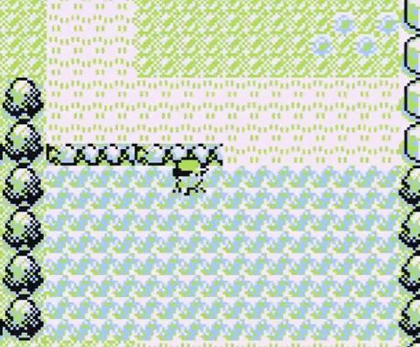
What is a video/camera transition
In cinema it’s a post-production technique. What about video games?
Used to connect one scene with another.
Moving the camera through the scene is also a camera transition.

Slide 3
The reasons behind camera transitions
Why don’t we use a basic cut?
We need to ‘hide’ the scene change process
Move backward or forward in time.
Spice up the narrative.
Aesthetics.

Slide 4
Basic types of transitions

Slide 5
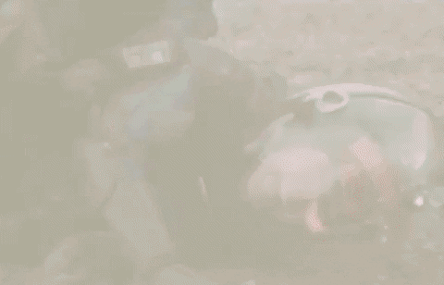
Fade in/out

Slide 6
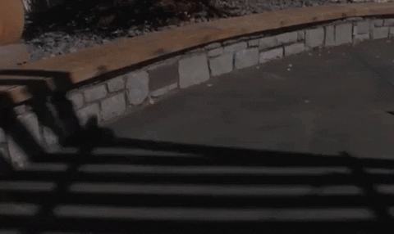
Dissolves

Slide 7
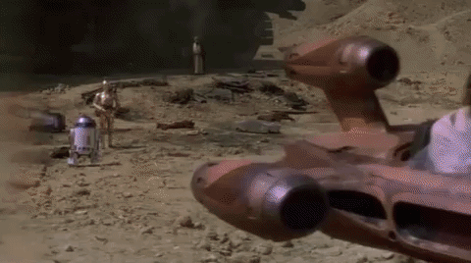
Wipes

Slide 8
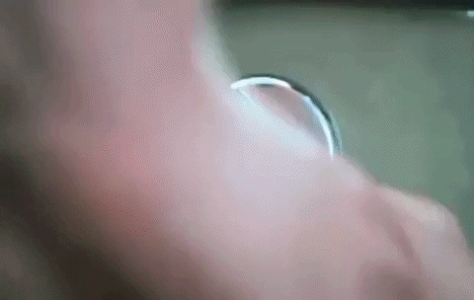
Zoom

Slide 9
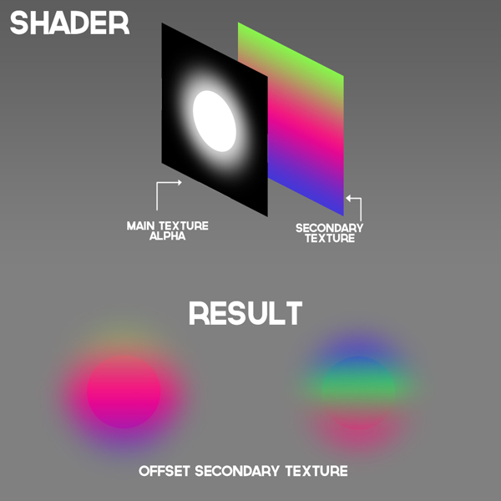
Shaders in camera transitions
Shaders are slices of code that are executed in the GPU.
They modify the way the image is rendered
The use of shaders is very extended in transitions due the possibilities they give.

Slide 10
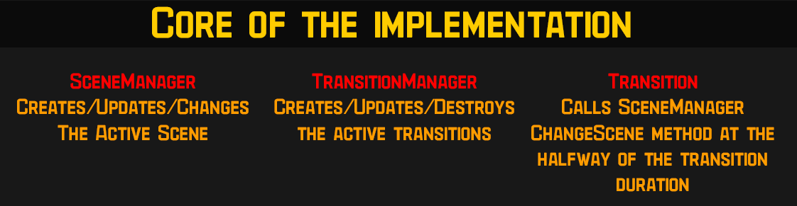
The implementation

Slide 11
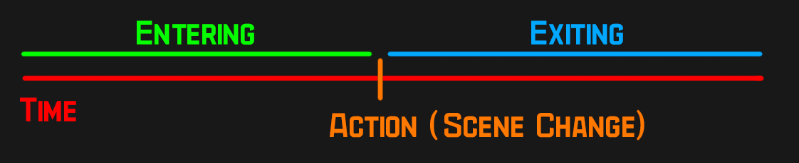
Transition structure
Where:
Entering is the time before the scene change.
Action is the frame of the scene change.
Exiting is the time after the scene change.

Slide 12
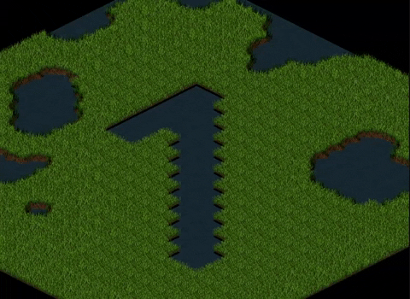
Let’s make our Wipe transition

Slide 13
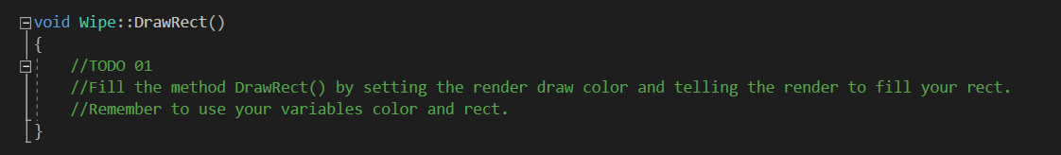
TODO 01
Fill the method DrawRect()
We’ll need to draw the black rectangle in the 3 fases!

Slide 14
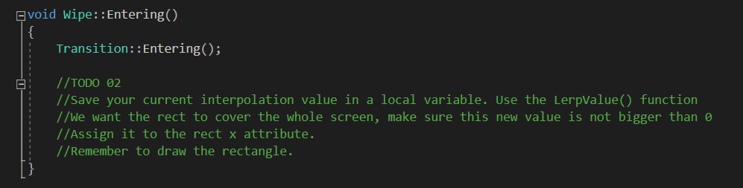
TODO 02
Implement the Entering method of the wipe transition.
We want it to come from the left of the screen and cover the whole scene!

Slide 15
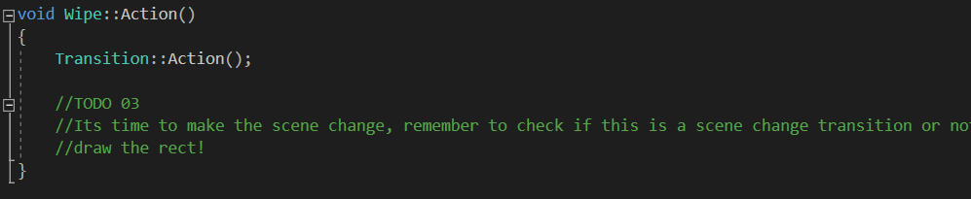
TODO 03
Implement the Action method of the wipe transition.

Slide 16
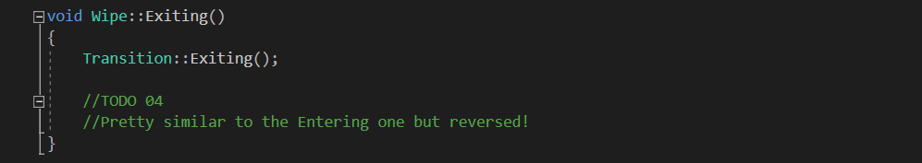
TODO 04
Implement the Exiting method of the wipe transition.

Slide 17
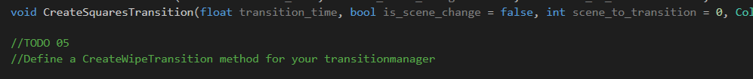
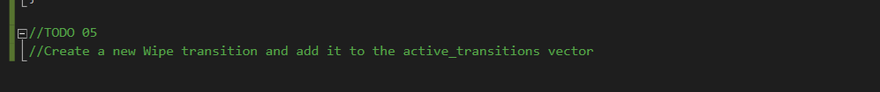
TODO 05
Create a CreateWipeTransition method in your TransitionManager.
Keep in mind what your wipe transition needs in the constructor.

Slide 18
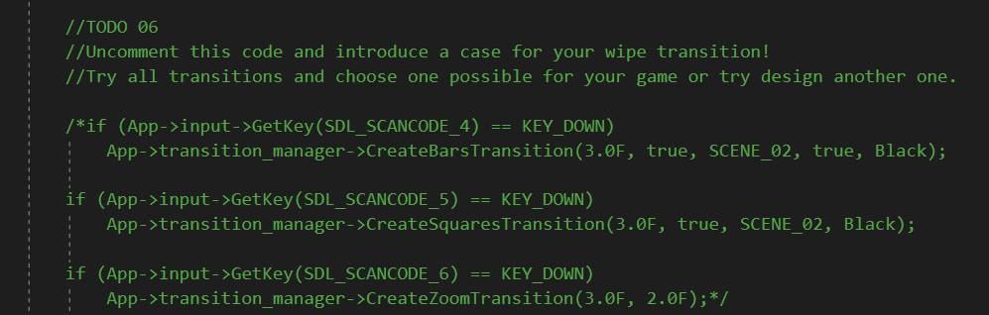
TODO 06
Introduce a case for your wipe transition.

Slide 19
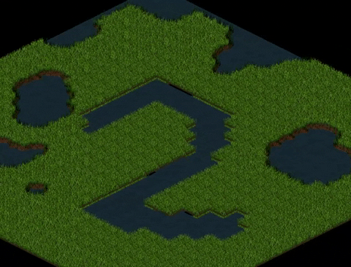
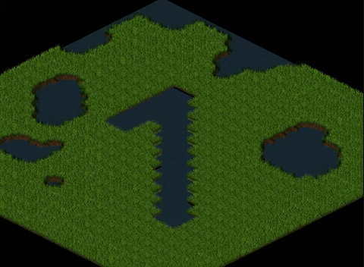
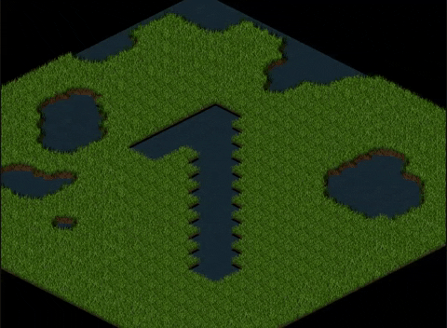
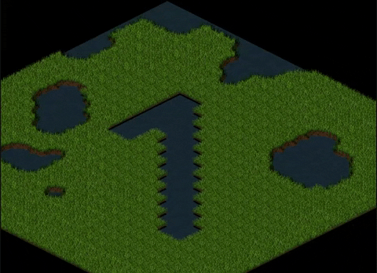
Extra! Choose the transition you like the most and take it for your Game!

Slide 20
Thank you
Contact:
mail: marc.guillen.96@gmail.com
github: marcgs96

